Slide 1
Information Retriveal

Slide 2
It can be defined as a software program which is used to find material(usual documents) of an unstructured nature(usually text) that satisfies an information need from within large collections(usually stored on computers).

Slide 3
Use Cases of Information Retrieval
Information Retrieval can be used in many scenarios, some of these are:
- Web Search
- E-mail Search

Slide 4
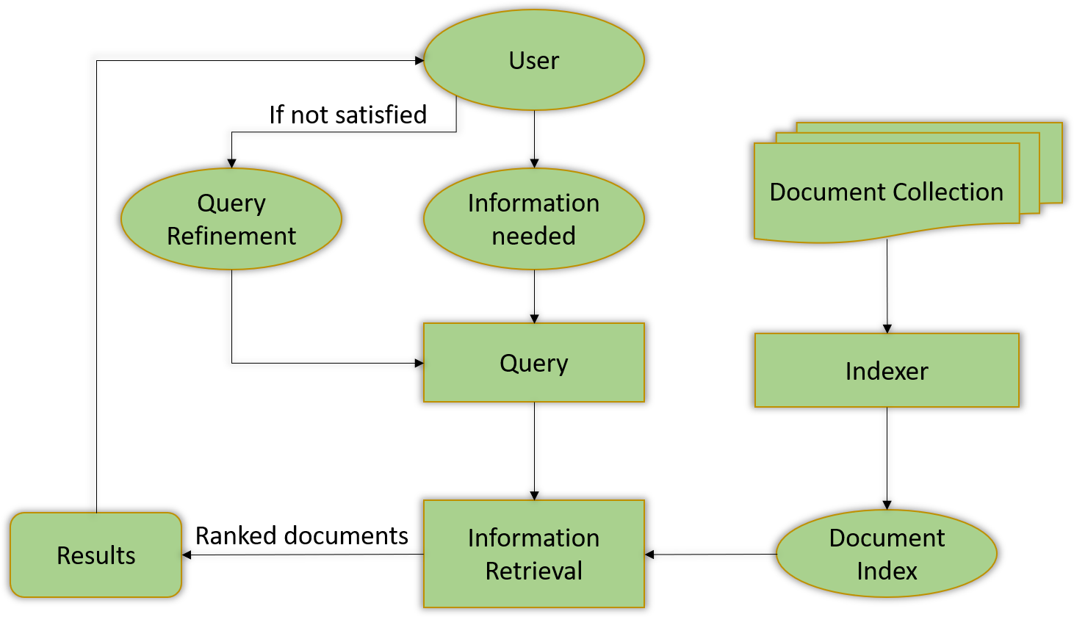

Slide 5
Two algorithm that are used in IF
1 . KNN
2 . K – Demensional Tree (KDTree)

Slide 6
Let’s take an example to understand in detail how KNN algorithm works. Given below is a small dataset to predict which Pizza outlet a person prefers out of Pizza Hut & Dominos.

Slide 7
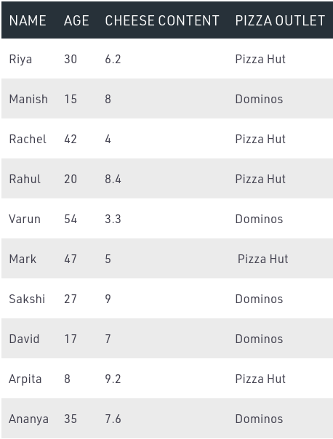

Slide 8
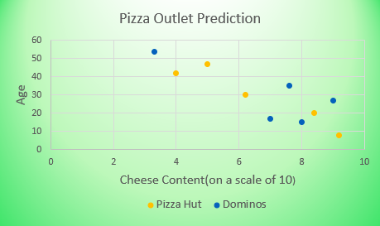
This data can be visualized graphically as:

Slide 9
KDTree
KDTree is a space partitioning data structure for organizing points in K-Dimensional space. It is an improvement over KNN.

Slide 10
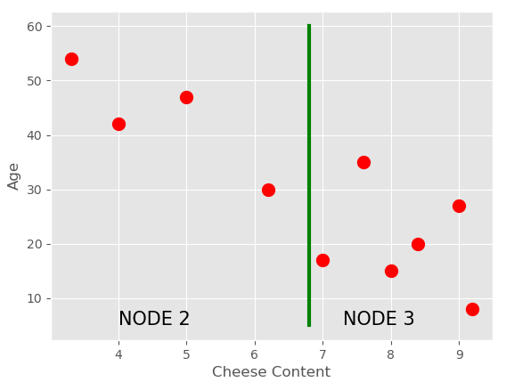

Slide 11
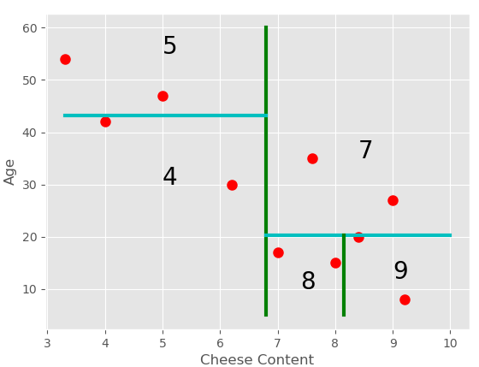

Slide 12
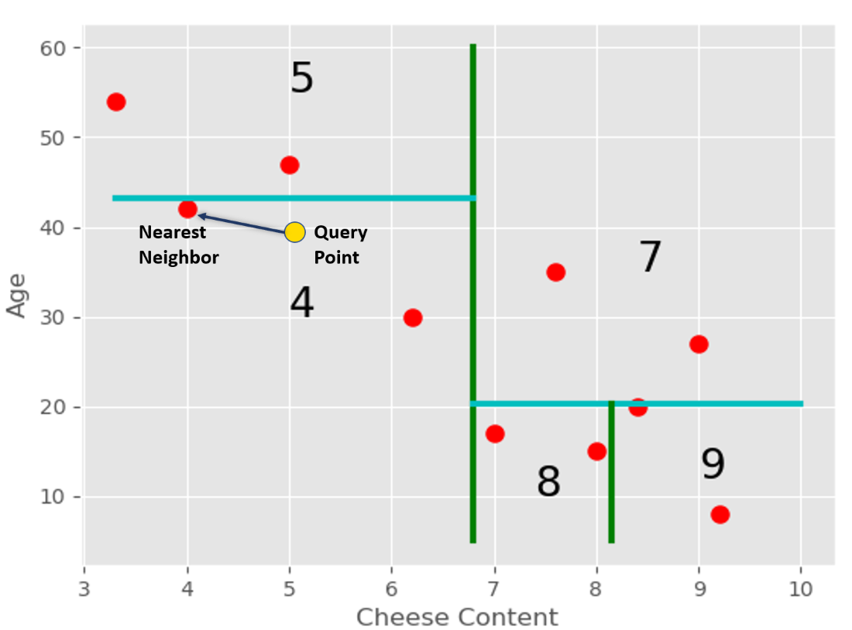

Slide 13
Comparsion between Brute-force vs k-Dtree
n: number of points in the training dataset
d: data dimensionality
k: number of neighbors that we consider for voting

Slide 14
Brute force
Training time complexity: O(1)
Training space complexity: O(1)
Prediction time complexity: O(k * n * d)
Prediction space complexity: O(1)

Slide 15
Kdtree
Training time complexity: O(d * n * log(n))
Training space complexity: O(d * n)
Prediction time complexity: O(k * log(n))
Prediction space complexity: O(1)

Slide 16
Which is better?
Brute force (O(k * n)): 3 * 10,000 = 30,000
k-d tree (O(k * log(n))): 3 * log(10,000) ~ 3 * 13 = 39
Comparison: 39 / 30,000 = 0.0013

